Slide 1
Rationale Management

Slide 2



















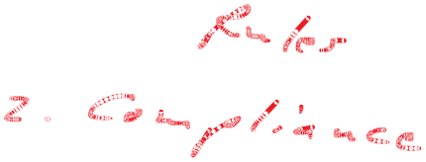

Slide 3
Rationale
Origins: (1650-60)
The fundamental reason or reasons serving to account for something
A statement of reasons
A reasoned exposition of principles
Logic, basis, grounds
  www.dictionary.com

Slide 4
Rationale Management
The justification of decisions.
Rationale models represent the reasoning that leads to the system, including its functionality and its implementation.
Rationale is critical in two areas:
  it supports the decision making
  It supports the capture of knowledge

Slide 5
Rationale Management
Rationale includes:
  Issues that were raised
  The alternatives that were considered
  The decisions that were made to resolve the issues
  The criteria that were used to guide decisions
  The debate (Argumentation) developers went through to reach a decision

Slide 6
Overview of Rationale
A rationale is the motivation behind a decision. It includes:
  Issue
  Alternatives
  Criteria
  Argumentation
  Decisions

Slide 7
Issue
  To each decision corresponds an issue to be solved so that development can proceed.
  An important part of the rationale is a description of the specific issue being solved. Issues are usually phrased as questions: How should years be represented?
  An issue represents a concrete problem, such as a requirement, a design, or a management problem. Issues most often represent problems that do not have a single correct solution and that cannot be resolved algorithmically. Issues are typically resolved through discussion and negotiation.

Slide 8
Alternatives
  Possible solutions that could address the issue under consideration.
  These include alternatives that were explored but discarded because they did not satisfy one or more criteria. E.g., representing years with binary 16-bit numbers requires too much processing.

Slide 9
Criteria
  Desirable qualities that the selected solution should satisfy. E.g., developers in the 1960s minimized memory foot prints.
  During requirements analysis, criteria are nonfunctional requirements and constraints (e.g., usability, number of input errors per day).
  During system design, criteria are design goals (e.g., reliability, response time)
  During project management, criteria are management goals and trade-offs (e.g., timely delivery versus quality).

Slide 10
Argumentation
  Software development decisions are not algorithmic.
  Developers discover issues, try solutions and argue their relative benefits.
  It is only after much discussion that a consensus is reached or a decision imposed.
  This argumentation occurs during all aspects of the decision process, including criteria, justifications, explored alternatives and trade-offs.

Slide 11
Decisions
  A decision is the resolution of an issue representing the selected alternative according to the criteria that were used for evaluation and the justification of the selection.
  Representing a year using two digits is a decision.
  Decisions are already captured in the system models we develop during requirements analysis and system design. Moreover, many decisions are made without exploring alternatives or examining the corresponding issues.

Slide 12
Rationale during requirements elicitation and requirements analysis
Decisions are made throughout the development process, and we can use rationale models during any development activity:
During requirements elicitation and requirements analysis, we make decisions about the functionality of the system, most often together with the client.
Decisions are motivated by user or organizational needs.
The justification of these decisions is useful for creating test cases during system integration and user acceptance.

Slide 13
Rationale during system design
We select goals and design the subsystem composition.
When identifying design goals, for example, we often base our decision on nonfunctional requirements.
Capturing the rationale of these decisions enables us to trace dependencies between design goals and nonfunctional requirements. This allows us to revise the design goals when requirements change.

Slide 14
Rationale during project management
We make assumptions about the relative risks present in the development process.
We are more likely to start development tasks related to a recently released component as opposed to a mature one.
Capturing the justifications behind the risks and fallback plans facilitates mitigation if these risks become problems.

Slide 15
Rationale during integration and testing
We discover interface mismatches between subsystems.
Accessing the rationale for the subsystems, we can often determine which change or assumption introduced the mismatch and correct the situation with minimal impact on the rest of the system.

Slide 16
Maintaining rationale is an investment of resources for dealing with change:
  We capture information now, to make it easier to revise decisions later, when changes occur.
  The amount of resources we are willing to invest depends on the type of project.
In building a complex system for a single customer, we will most likely revise and upgrade the system several times over a long period. In this case the client may require that rationale be recorded.

Slide 17
Levels of Rationale Capture (Organizational Maturity)
No explicit rationale capture
Rationale reconstruction
Rationale capture
Rationale integration

Slide 18
Levels of Rationale Capture
No explicit rationale capture
  Resources are spent only on development. The documentation focuses only on system models. Rationale information is present only in the developers’ memories and in communication records such as email messages, memos and faxes.
Rationale reconstruction
  Resources are spent in recovering design rationale during the documentation effort. The design criteria and motivation behind major architectural decisions is integrated with the corresponding system models. Discarded alternatives and argumentation are not captured explicitly.

Slide 19
Levels of Rationale Capture
Rationale capture
  Major effort is spent in capturing rationale as decisions are made. Rationale information is documented as a separate model and cross-referenced with other models. E.g., issue models represent rationale with a graph of nodes, each representing an issue, an alternative, or an evaluation criteria. The rationale behind the requirements model can then be captured by attaching issue models to user cases.
Rationale integration
  The rational model becomes the central model developers use. Rationale produced during different phases are integrated into a live and searchable information base. Changes to the system occur first in the information base as a discussion followed by one or more decisions. The system models represent the sum of the decisions captured in the information base.

Slide 20
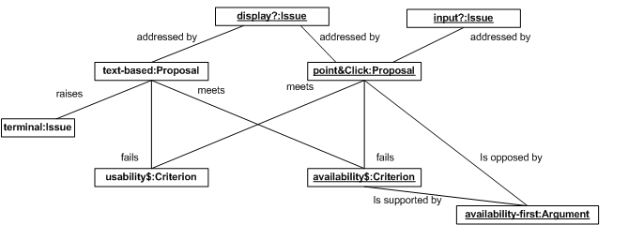
Rationale Concepts
Availability-first!:Argument | Point-and-click interfaces are much more complex to implement than text-based interfaces. They are also more difficult to test, since the number of actions available to the dispatcher is much larger. The point-and-click interface risks introducing fatal errors in the system that would offset any usability benefit the interface would provide

Slide 21
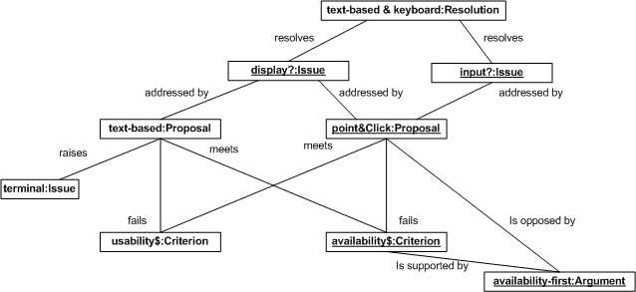
Text-based & keyboard:Resolution | We select a text-based display and keyboard input for the traffic control user interface. The terminal emulation should provide line characters that allow track circuits to be drawn in text mode. This decision is motivated by the relative simplicity and reliability of text-based interfaces compared with point-and-click interfaces. We are aware that this decision costs some usability as fewer data can be presented to the dispatcher and issuing commands by the dispatcher will be slower and more prone to errors.

Slide 22
Proposal
  A proposal represents a candidate answer to an issue.
  A proposal need not be a good or valid answer to the issue it addresses. Proposals enable developers to explore the solution space thoroughly. Proposals addressing the same issue can overlap.

Slide 23
Criterion
  A criterion is a desirable quality that proposals addressing a specific issue should have.
  Design goals, such as response time or reliability, are criteria used for addressing design issues. Management goals, such as minimum cost or minimum risk, are criteria used for addressing management issues.
  A set of criteria indicates the dimensions against which each proposal is assessed. A proposal that meets a criterion is said to be assessed positively against that criterion. Similarly, assessed negatively would indicate a proposal that fails to meet a criterion.
  Criteria are “goodness measures”.

Slide 24
Argument
  An opinion expressed by a person, agreeing or disagreeing with a proposal, a criterion, or an assessment.
  Arguments capture the debate that drives the exploration of the solution space, defines the goodness measures, and eventually leads to a decision.

Slide 25
Resolution
  Represents the alternative selected to close an issue.
  A resolution represents a decision and has an impact on one of the system models or the task model.
  A resolution can be based on the several proposals and summarizes the justification that leads to the decision.
  A resolution is implemented in terms of one or more action items. A person is assigned an action item, which is a task with a completion date. Action items are not part of the rationale per se, but rather they are part of the task model. Action items are described here because they are tightly integrated into the issue model.

